Slide 1
Principles of International Finance and Open Economy Macroeconomics
Cristina Terra

Slide 2
Chapter 4 What is the Optimum Current-Account Level?
Cristina Terra

Slide 3
Introduction
Is it better to have a current-account deficit or surplus?
How does an income shock, such as a change in international export prices, affect the current-account balance of a country?
Therefore, the answer to this and other similar questions depends on the investment and savings decisions made by individuals, and how these decisions are affected by economic shocks.
The intertemporal model of current-account adjustment does exactly that: it studies the optimum choices for savings and investment in a country, and the current account is the result of these choices.

Slide 4
Plan
Basic Hypotheses
Consumption Smoothing
Comparing with a Closed Economy
How Economic Shocks Affect the Current Account
Adding Government
The Model with Production and Investment
The Model and the World

Slide 5
Plan
Basic Hypotheses
Consumption Smoothing
Comparing with a Closed Economy
How Economic Shocks Affect the Current Account
Adding Government
The Model with Production and Investment
The Model and the World

Slide 6
Basic Hypotheses
There is only one good in the economy.
This one good can be interpreted as the consumption basket composed of all goods consumed.
There are only two periods, which can be interpreted as the present and the future.
It is a small, open economy.
A small economy: the amount the country imports or exports does not affect the international prices of goods, and the amount it borrows or lends does not affect international interest rates.
The country it can freely borrow at a constant interest rate.
There is no uncertainty.

Slide 7
Plan
Basic Hypotheses
Consumption Smoothing
Comparing with a Closed Economy
How Economic Shocks Affect the Current Account
Adding Government
The Model with Production and Investment
The Model and the World

Slide 8
Consumption Smoothing
Assumption:
no production nor investment
each consumer receives an endowment of goods each period.
Preferences present consumption $(c_{1}^{i})$ and future consumption $(c_{2}^{i})$ can be represented by the following intertemporal utility function:
$$U_{1}^{i}≡u\left(c_{1}^{i}\right)+βu\left(c_{2}^{i}\right),$$
where:
intertemporal discount factor $β$, $0<β<1$, measures the degree of consumer patience,
Assumption: 𝑢$\left(∙\right)$ is increasing and strictly concave: $u′\left(∙\right)>0$ and$u^{′′}\left(∙\right)<0$

Slide 9
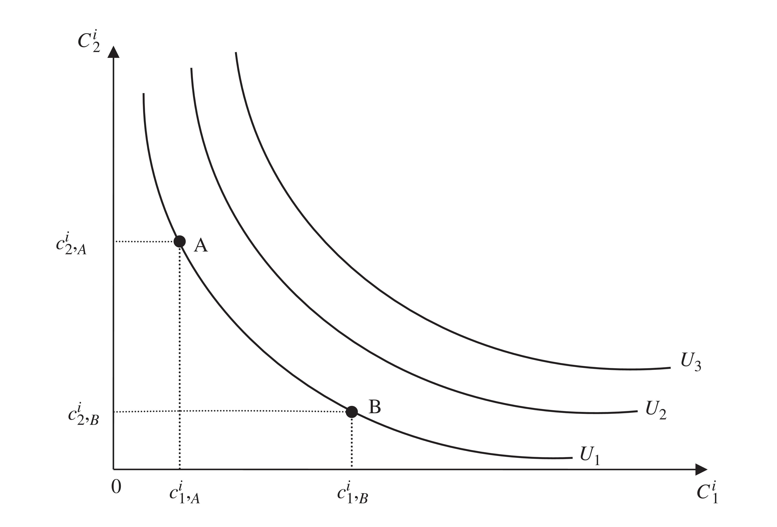
Map of Indifference Curves
Slope of the indifference curve = marginal rate of substitution (MRS): $\left|TMS\right|≡\left|{\left.\frac{dc_{2}^{i}}{dc_{1}^{i}}\right\rceil }_{U_{1}^{i}=\overline{u}}\right|=\frac{u^{′}\left(c_{1}^{i}\right)}{βu^{′}\left(c_{2}^{i}\right)}$

Slide 10
Budget constraint
Each period they receive allowance $y_{t}^{i}$ of the good, and can then lend or borrow from the international credit market at interest rate r.
To simplify, we will consider the good as the numeraire: its price is always equal to 1.
The intertemporal budget constraint establishes that the present value of consumption should be equal to the present value of income:
$$c_{1}^{i}+\frac{c_{2}^{i}}{1+r}=y_{t}^{i}+\frac{y_{2}^{i}}{1+r}.$$

Slide 11
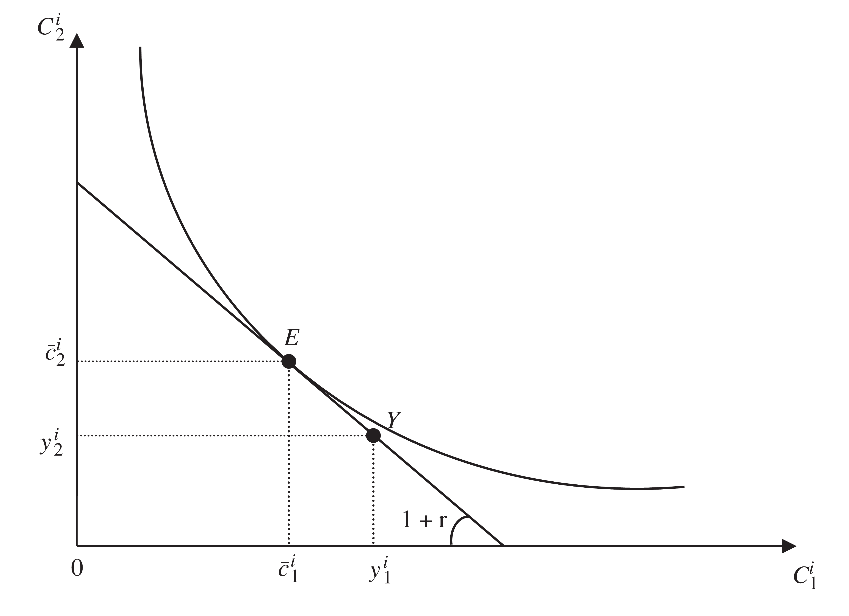
Consumer’s Problem
Slope of budget restraint: $−\left(1+r\right)$

Slide 12
Consumer’s Problem
The consumer chooses the amount to consume so as to maximize its utility), subject to budget constraint.
The budget restraint states that:
$$c_{2}^{i}=\left(1+r\right)\left(y_{1}^{i}−c_{1}^{i}\right)+y_{2}^{i}$$
Substituting $c_{2}^{i}$ in the utility function, the consumer’s problem can be rewritten as:
$$\max_{c_{1}^{i}}\left(c_{1}^{i}\right)+βu\left(\left(1+r\right)\left(y_{1}^{i}−c_{1}^{i}\right)+y_{2}^{i}\right)$$

Slide 13
Consumer’s Problem
The first order condition for a level of consumption that maximizes utility is = Euler equation:
$$u^{′}\left(c_{1}^{i}\right)=\left(1+r\right)βu^{′}\left(c_{2}^{i}\right)$$
The consumer cannot increase their utility by reallocating consumption between periods
Intuition:
by consuming one unit less in the present, utility reduces in $u^{′}\left(c_{1}^{i}\right)$
this amount is saved, rendering$\left(1+r\right)$
next period, with $\left(1+r\right)$ additional units consumerd, utility increases in $\left(1+r\right)βu^{′}\left(c_{2}^{i}\right)$.

Slide 14
Consumer’s Problem
The Euler equation can also be written as:
$$\frac{u^{′}\left(c_{1}^{i}\right)}{βu^{′}\left(c_{2}^{i}\right)}=1+r$$
Left side = the slope of the indifference curve
Right side = the slope of the budget constraint, interpreted as the relative price of consumption between the two periods.
The consumer maximizes utility, subject to the budget constraint, when the MRS of consumption between the two periods is equal to its relative price.

Slide 15
Consumer’s Problem
In terms of the Figure: consumer chooses a point on the budget constraint belonging to an indifference curve that is farthest from the origin.
This point is that where an indifference curve passes tangent to the budget constraint, i.e., with the same slope (point E).
Notice that access to the international credit market allows the value of consumption for reach period to be different from the endowment.
Endowment $\left(y_{1}^{i},y_{2}^{i}\right)$ is different from consumption $\left({\overline{c}}_{1}^{i},{\overline{c}}_{2}^{i}\right)$.

Slide 16
consumption smoothing
To know the value of consumption for each period, we need to know the functional form of $u\left(∙\right)$, the value of $β$ and r.
In order to advance in the analysis without knowing the functional form of function $u\left(∙\right)$, we suppose that $β=\frac{1}{1+r}$.
The Euler equation becomes $u^{′}\left(c_{1}^{i}\right)=u^{′}\left(c_{2}^{i}\right)$.
Given the strict concavity of $u\left(∙\right)$, we then have that:
$$c_{1}^{i}=c_{2}^{i}≡{\overline{c}}^{i}$$
perfect consumption smoothing.

Slide 17
Individual and Aggregate Consumption
From the budget constraint, with perfect consumption smoothing:
$${\overline{c}}^{i}=\frac{\left(1+r\right)y_{1}^{i}+y_{2}^{i}}{2+r}$$
Aggregate endowment and consumption are the sum of individual endowment and consumption of all consumers.
Assumption: a continuum of identical individuals in interval $\left[0,1\right]$.
With these hypotheses, aggregate are equal to individual values
Hence:
$\overline{C}=\frac{\left(1+r\right)Y_{1}+Y_{2}}{2+r}$, when $β=\frac{1}{1+r}$

Slide 18
Current Account
The identity of national accounts:
$$CA_{t}=Y_{t}+rB_{t}−C_{t}$$
Given that there is neither government nor investment
$B_{t}$is the Net International Investment Position (NIIP)
Here: the CA balance depends only on the decision to save, on the right side of the equation.
Positive savings = positive CA balance and the country lends to the rest of the world
Negative savings = the country borrows.

Slide 19
Current Account
In the case where$β=\frac{1}{1+r}$, we have that:
$$CA_{1}=\frac{Y_{1}−Y_{2}}{2+r}+rB_{1}$$
$$CA_{2}=\frac{\left(1+r\right)\left(Y_{1}−Y_{2}\right)}{2+r}+rB_{2}$$
According to the balance of payments, the current and financial accounts balances should be equal, hence:
$${CA}_{t}=B_{t+1}−B_{t}$$

Slide 20
Current Account
To simplify: $B_{1}=0$ and$B_{3}=0$. We the have that:
$$CA_{1}=B_{2}−B_{1}=B_{2}$$
$$CA_{2}=B_{3}−B_{2}={−B}_{2}$$
and, therefore:
$CA_{1}=−CA_{2}$,
A deficit in CA in the first period should be compensated with a surplus in the second period for the economy to honor is foreign commitments.

Slide 21
Current Account
We then have that:
$$CA_{1}=Y_{1}−C_{1}=B_{2}$$
Given there was no initial debt, the CA balance corresponds to first period savings.
Substituting the value of consumption, we get:
$${CA}_{1}=\frac{Y_{1}−Y_{2}}{2+r}=−{CA}_{2}.$$
Acountry smooths its aggregate consumption by means of the international financial market.
The current account is other than zero when income is different across periods.

Slide 22
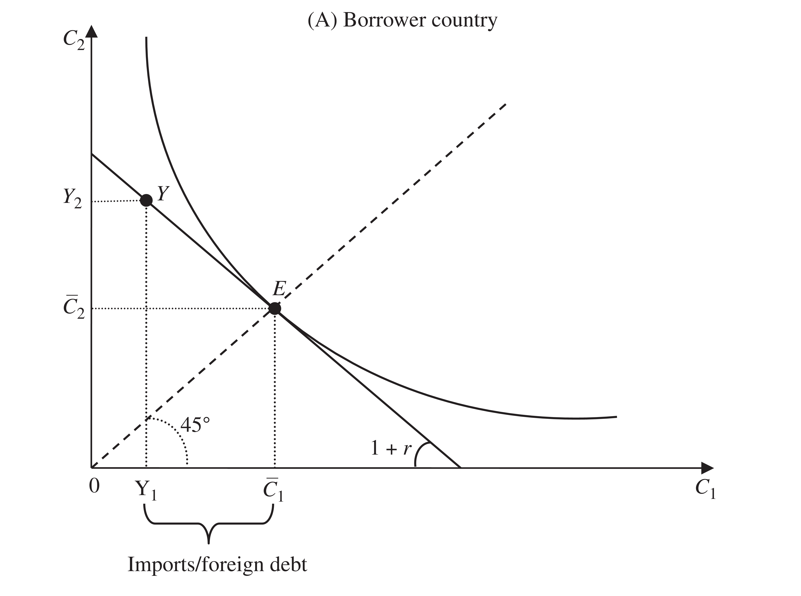
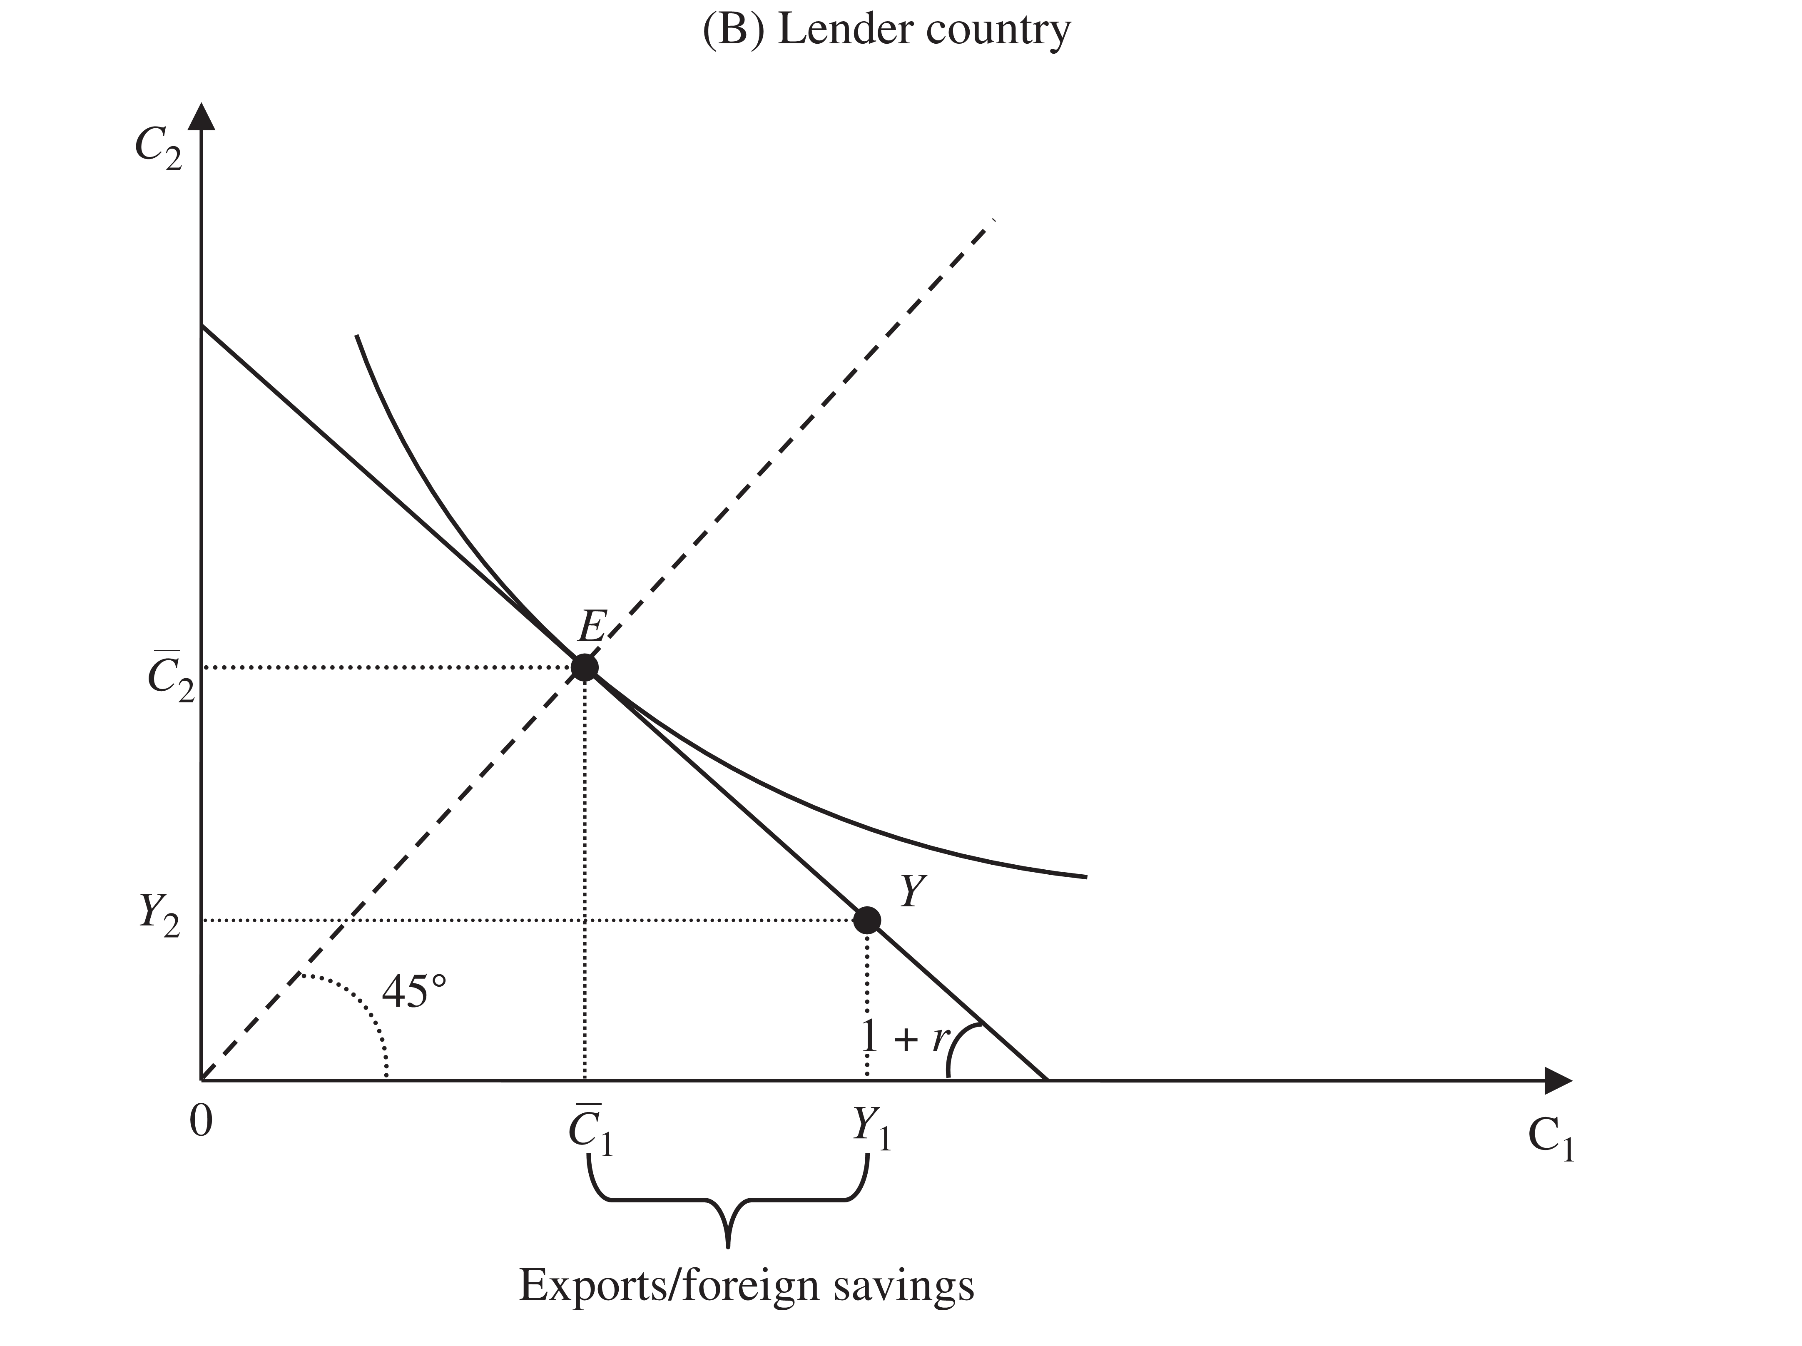
Borrower vs. Lender Country
Borrower country: $Y_{1}<Y_{2}$ Lender country: $Y_{1}>Y_{2}$

Slide 23
Borrower vs. Lender Country
Is it better to have a current-account deficit or surplus?
For a developing country that is growing quickly, the best strategy is to go into debt in the present. In the future, the country will have a greater income and be able to pay its debt without reducing its level of consumption.
For a country that has attained a high level of development and is growing at smaller rates, the best strategy is to save so as to live from the income in the future.

Slide 24
Plan
Basic Hypotheses
Consumption Smoothing
Comparing with a Closed Economy
Equilibrium Interest Rate in a Closed Economy
Benefiting from Access to International Markets
How Economic Shocks Affect the Current Account
Adding Government
The Model with Production and Investment
The Model and the World

Slide 25
Comparing with a Closed Economy
To understand the benefit generated by participation in international markets, let us see what the economic allocation would be if the economy were an autarchy.
In a closed economy, consumption must equal endowment: $C_{1}=Y_{1}$ and $C_{2}=Y_{2}$.
As in the open economy, consumers choose consumption so as to maximize utility, subject to budget constraint.
The budget constraint in a closed economy is like the one of an open economy, with the difference that they face a domestic interest rate $r^{A}$.

Slide 26
Interest Rate in a Closed Economy
What is the equilibrium rate of interest in an autarchy?
With identical individuals, the only way to not have aggregated debt nor savings is for each of the individuals to consume exactly their endowment each period.
The equilibrium interest rate in an autarchy is that which encourages each one to choose to consume their endowment each period.
Substituting $C_{1}=Y_{1}$ and $C_{2}=Y_{2}$ in the Euler equation, we get:
$$\frac{u^{′}\left(Y_{1}\right)}{βu^{′}\left(Y_{2}\right)}=1+r^{A}$$

Slide 27
Borrower Country

Slide 28
Lender Country

Slide 29
Interest rate in the Closed Economy
For a borrower country, the slope of the indifference curve that passes through the endowment point is higher than the international interest rate.
The current interest rate in autarky is higher than the international interest rate
Intuition: since consumers would choose to borrow in the first period if they had access to the international capitals market, they should face a higher cost to do so, that is, a higher interest rate, to choose not to borrow while in autarky.

Slide 30
Interest rate in the Closed Economy
For a lender country, interest rate in autarky is lower than the international interest rate.
A creditor country is relatively abundant in present output compared to the rest of the world and, therefore, exports present consumption and imports future consumption.

Slide 31
Benefiting from Access to International Markets
Countries must benefit from the access to international financial markets, since make an effort to fulfill their international obligations so as to not be ostracized from these markets.
We can measure the gain obtained from openness by comparing the utility level an economy in autarky attains to that of an open economy.
In terms of the figures, the benefit of openness is proportional to the distance between the indifference curve that crosses the endowment point, which corresponds to consumption in autarky, and the indifference curve that crosses the point of consumption in an open economy.

Slide 32
Benefiting from Access to International Markets
Both borrowers and lenders benefit from access to international markets, as we can see from the figures.
Source of the gain: consumption smoothing from the access to international markets.
The gain from openness is greater, the greater the difference between the international interest rate and the domestic rate under autarky.
Openness => expansion of the set of consumption possibilities biased in favor of the period where consumption is relatively limited in the country.
The greater the difference in interest rates, the greater the (biased) expansion of the consumption possibilities.
Countries that either borrow more or lend more are those that would be most harmed if they did not have access to international markets.

Slide 33
Plan
Basic Hypotheses
Consumption Smoothing
Comparing with a Closed Economy
How Economic Shocks Affect the Current Account
Increase in International Interest Rates
Higher Value Attributed to Future Consumption
Positive Shock to Income
Adding Government
The Model with Production and Investment
The Model and the World

Slide 34
How Economic Shocks Affect the Current Account
The current-account balances of countries oscillate between deficits and surpluses over time.
These movements are generally responses to economic shocks or changes.
Let us consider, in turn:
an increase in international interest rates,
a higher value attributed to future consumption, and
a positive shock to income.

Slide 35
increase in international interest rates
Substitution effect of the interest rate on consumption:
International interest rate = the relative price between present and future consumption.
An increase in international interest rates causes present consumption to be relatively more expensive.
From Euler equation: higher $r$ => lower present consumption relative to future consumption.

Slide 36
increase in international interest rates
Income effect of the interest rate on consumption:
Borrower country: higher $r$= higher cost of its debt
=> lower disposable income for consumption.
Lender country: higher $r$= higher revenue received with its credit
=> higher disposable income.
The income effect from an increase in interest rate implies a rise in consumption for lender countries and a reduction for borrower countries.

Slide 37
increase in international interest rates
For an indebted country, both the income effect and the substitution effect cause a decrease in present consumption.
Consequently, there is a reduction in the current-account deficit in the first period, which is measured as the difference between consumption and income. The indebtedness, therefore, decreases.
For a lender country, the income effect and the substitution effect have opposite effects on consumption in the first period.
The current-account surplus for the lender country increases if the substitution effect is stronger than the income effect, and reduces, if in the opposite case.

Slide 38
increase in international interest rates
For an economy with no debt or initial credit, and where initially $β=\frac{1}{1+r}$
We measure the impact of a marginal increase in interest rates on consumption by taking the derivative of consumption with respect to interest rates. We get:
$$\frac{∂\overline{C}}{∂r}=\frac{Y_{1}−Y_{2}}{{\left(2+r\right)}^{2}}$$
The impact of the interest rate on consumption is positive if $Y_{1}>Y_{2}$, i.e., for a lender country, while it is negative to the contrary.
Lender country: the income effect supplants the substitution effect => higher consumption and lower CA balance.
Borrower country: both the income effect and the substitution effects lead to a reduction in consumption => lower the CA deficit.

Slide 39
Higher Value Attributed to Future Consumption
Countries have seen significant increases in life expectancy among their citizens.
When people expect to live longer, it is natural for them to attribute more value to future consumption.
In our model, this phenomenon can be seen in an increase of the intertemporal choice factor$β$.
The slope of the indifference curve, $\frac{u^{′}\left(C_{1}\right)}{βu^{′}\left(C_{2}\right)}$ reduces with the increase of$β$. For a given international interest rate, the Euler equation will be satisfied with a smaller $\frac{C_{1}}{C_{2}}$ ratio.
Lower current consumption => higher current account

Slide 40
Positive Shock to Income
Assume that $β=\frac{1}{1+r}$ (hence, ${ C}_{1}=C_{2}=\overline{C}$) and that, initially, ${ Y}_{1}=Y_{2}=Y$
=> $\overline{C}=Y$ and the CA will be balanced in both periods
Now suppose there is a positive shock to the first period output: ${ Y}_{1}=Y^{′}>Y=Y_{2}$
Example: a temporary improvement in terms of trade
From the equation that determines current account, we obtain:
$$CA_{1}=\frac{Y^{′}−Y}{2+r}>0$$
The current account in the first period becomes positive.
The country saves a portion of the additional income from the first period to be able to also consume more in the future and thereby smooth consumption.

Slide 41
Positive Shock to Income
What would happen if the increase in product were permanent?
Example: an increase in productivity
Output remains the same across periods, only at a higher level:${ Y}_{1}=Y_{2}=Y^{′}$.
The CA remains balanced.
The country smooths consumption by totally consuming the additional income each period. There is no need to save the additional income.
Conclusion: permanent output shocks do not alter the CA balance, while positive temporary shocks increase it.

Slide 42
Plan
Basic Hypotheses
Consumption Smoothing
Comparing with a Closed Economy
How Economic Shocks Affect the Current Account
Adding Government
The Model with Production and Investment
The Model and the World

Slide 43
Adding Government
Assumptions:
the government collects taxes and uses them for public expenditures.
the government can lend or borrow each period at the same interest rate r.
The government budget constraint is analogous with the private sector:
$$G_{1}+\frac{G_{2}}{1+r}=T_{1}+\frac{T_{2}}{1+r}$$
where $G_{t}$ and $T_{t}$ are expenditures and taxes for period t, respectively.
With taxes being paid, the consumer budget constraint becomes:
$$C_{1}+\frac{C_{2}}{1+r}=Y_{1}−T_{1}+\frac{{Y_{2}−T}_{2}}{1+r}$$
Substituting the government budget constraint in the previous equation, we have:
$$C_{1}+\frac{C_{2}}{1+r}=Y_{1}−G_{1}+\frac{{Y_{2}−G}_{2}}{1+r}$$

Slide 44
Adding Government
The inclusion of government does not change the rate of substitution between present consumption and future consumption: the slope of the consumer budget constraint remains unaltered.
the new budget constraint is smaller, given that the disposable income becomes $Y_{1}−G_{1}+\frac{{Y_{2}−G}_{2}}{1+r}$, instead of $Y_{1}+\frac{Y_{2}}{1+r}$.
Graphically, it a straight line closer to the origin than when there is no government.

Slide 45
Adding Government
The consumption path, with the presence of government and assuming $β=\frac{1}{1+r}$, will be:
$$C_{1}=C_{2}=\overline{C}=\frac{\left(1+r\right)\left(Y_{1}−G_{1}\right)+\left(Y_{2}−G_{2}\right)}{2+r}$$
Consumption depends on the amount of government expenditures.
how expenditures or taxes are spread over time does not affect the choice of private consumption.

Slide 46
Adding Government
Current account: from national accounts identity, we have:
$${CA}_{t}=Y_{t}+rB_{t}−C_{t}−G_{t}$$
Taking $B_{1}=0$, and substituting the optimal consumption, we arrive at:
$${CA}_{1}=\frac{\left(Y_{1}−Y_{2}\right)−\left(G_{1}−G_{2}\right)}{2+r}.$$

Slide 47
Adding Government
With equal government expenditures between periods, adding government does not affect the CA balance
Intuition: the reduction in private consumption is exactly equal to government expenditure when it is equal between periods => private consumption is substituted by government consumption.
On the other hand, if government spends relatively more in the first period in relation to the second, the CA balance in the first period is lower with government than without.
the reduction of private consumption does not totally compensate government consumption => aggregate expenditures increases, leading to a smaller CA balance.
In sum, government will affect the CA balance as long as it alters the relative aggregate expenditures between the two periods.

Slide 48
Plan
Basic Hypotheses
Consumption Smoothing
Comparing with a Closed Economy
How Economic Shocks Affect the Current Account
Adding Government
The Model with Production and Investment
Graphic Representation
The Relation Between Investment and Savings.
The Model and the World

Slide 49
The Model with Production and Investment
The current-account balance depends on the aggregate saving and investment.
Now we will add the decision to invest to that of saving.
Output is the result of production, using the stock of capital available in the economy, through the production function:
$$Y_{t}=F\left(K_{t}\right)$$
Increasing: $F^{′}\left(∙\right)>0$¸
with decreasing returns to scale: $F^{′′}\left(∙\right)<0$,
$K_{t}$: the stock of capital.
$F\left(0\right)=0$

Slide 50
The Model with Production and Investment
The capital stock is the result of investment made over time.
Assuming there is no depreciation of capital, capital accumulation is equal to investment:
$$K_{t+1}−K_{t}=I_{t}$$
The consumer budget constraint now incorporates production and investment:
$$C_{1}+I_{1}+\frac{C_{2}+I_{2}}{1+r} = Y_{1}+\frac{Y_{2}}{1+r}$$
Present value of
consumption and investment
Present value of
dispsable income

Slide 51
The Model with Production and Investment
The consumer chooses consumption and investment in both periods, $C_{1}$, $I_{1}$, $C_{2}$e$I_{2}$, so as to maximize their utility, subject to the budget constraint, the production and investment functions.
According to the investment equation, the stock of capital in the second period is given by:
$$K_{2}=I_{1}+K_{1}.$$
Therefore, production in periods 1 and 2 can be written as:
$$Y_{1}=F\left(K_{1}\right) and Y_{2}=F\left(I_{1}+K_{1}\right)$$

Slide 52
The Model with Production and Investment
Since there are only two periods in our world, it does not make sense to leave positive capital stock for a third period, which does not exist.
Therefore, the consumer must “disinvest” all they can in the last period:
$$K_{3}=0 and I_{2}=−K_{2}=−\left(I_{1}+K_{1}\right)$$
Substituting into the budget constraint, we get:
$$C_{1}+I_{1}+\frac{C_{2}−\left(I_{1}+K_{1}\right)}{1+r}=F\left(K_{1}\right)+\frac{F\left(I_{1}+K_{1}\right)}{1+r}$$
$$Y_{2}$$
$$Y_{1}$$

Slide 53
Solving The Model with Production and Investment
To solve consumer problem, we isolate second period consumption in the budget contraint:
$$C_{2}=\left(1+r\right)\left[F\left(K_{1}\right)−C_{1}−I_{1}\right]+F\left(I_{1}+K_{1}\right)+I_{1}+K_{1}$$
and substitute it into the utility function:
$$U_{1}=u\left(C_{1}\right)+β\left\{u\left[F\left(K_{1}\right)−C_{1}−I_{1}\right]+F\left(I_{1}+K_{1}\right)+I_{1}+K_{1}\right\}$$
The consumer $C_{1}$ and $I_{1}$ so as to maximize the utility function above.
To find the optimal $C_{1}$ and $I_{1}$, we take the derivative of the utility function with respect to these two variables and make them equal to zero.

Slide 54
Solving The Model with Production and Investment
Taking the derivative with respect to $C_{1}$ and equaling to zero:
$$u^{′}\left(C_{1}\right)=\left(1+r\right)βu^{′}\left(C_{2}\right)$$
which is the same Euler equation from the model with no investment.
the inclusion of production and investment did change the incentives for the decision between consumption and saving.
Taking the derivative with respect to $I_{1}$ and equaling to zero:
$$F^{′}\left(K_{2}\right)=r$$
the marginal productivity of capital is equal to the interest rate at the optimum point. The

Slide 55
Solving The Model with Production and Investment
With the first order conditions, the investment and the production functions, and the budget constraint, it is possible to derive the values of $C_{1},I_{1}$, $C_{2}$, and $I_{2}$ (and $K_{2}$).
The first order conditions indicate that the decision to consume between periods is not dependent on the decision to produce.
Savings decision to smooth consumption is not affected by the amount they decide to invest.
The level of investment will affect overall consumption level, given that income depends on second period production, and this, in turn, depends on the level of investment.
However, the relative consumption across periods is not affected by investment.

Slide 56
Graphic representation
To better understand the intuition for the relationship between the decisions to consume and to invest, let us construct a graphic analysis of the problem.
We will begin by determining the resources constraint for the country.
It is possible to transfer output between periods through through investment.
Let us rewrite the budget constraint:
$$C_{1}+\frac{C_{2}}{1+r}=Y_{1}−I_{1}+\frac{Y_{2}−I_{2}}{1+r}$$
It states that the amount of resources available for consumption is the present value of production subtracted from investment.
Hence, to maximize the utility derived for consumption, the investment decision should maximize the available resources on the right side of the equation.

Slide 57
Graphic representation
We begin by determining the possible combinations of $Y_{1}−I_{1}$ and $Y_{2}−I_{2}$ of the economy.
Defining $R_{t}≡Y_{t}−I_{t}$ and using the production functions, we can write:
$$I_{1}=F\left(K_{1}\right)−R_{1},$$
$$F\left(I_{1}+K_{1}\right)=R_{2}+I_{2}$$
$$Y_{1}$$
$$Y_{2}$$

Slide 58
Graphic representation
Using the fact that in the second period all existent capital is disinvested, the previous equation can be written as:
$$F\left(I_{1}+K_{1}\right)=R_{2}−\left(K_{1}+I_{1}\right)$$
Finally, substituting investment in the first period as defined in the previous slide in the equation above , we obtain the resources constraint for the economy:
$$R_{2}=F\left(K_{1}+F\left(K_{1}\right)−R_{1}\right)+F\left(K_{1}\right)−R_{1}+K_{1}$$
$$I_{2}$$

Slide 59
Graphic representation
$$R_{2}=F\left(K_{1}+F\left(K_{1}\right)−R_{1}\right)+F\left(K_{1}\right)−R_{1}+K_{1}$$
the resources constraint, if this were a closed economy.
$R_{t}$ would be the amount consumed each period.
Sloped of $R_{t}$:
$$\frac{dC_{2}}{C_{1}}=−\left(1+F^{′}\left(K_{2}\right)\right)$$
and the concavity:
$$\frac{d^{2}C_{2}}{{\left({dC}_{1}\right)}^{2}}=F^{′′}\left(K_{2}\right)<0$$

Slide 60
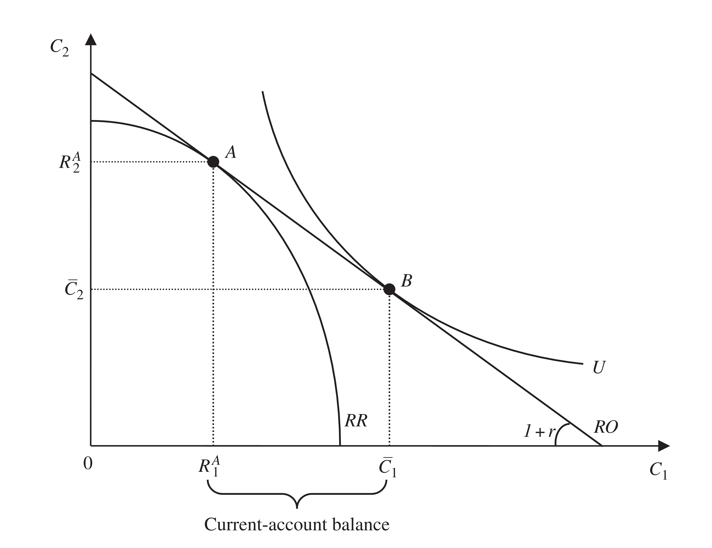
Graphic representation

Slide 61
Graphic Representation
The individual chooses the point on the RR restriction of resource that offers the greatest availability of resources $R_{1}+\frac{R_{2}}{1+r}$.
$R_{1}+\frac{R_{2}}{1+r}$ is a line with slope $−\left(1+r\right)$, and its height indicates the value of resource availability.
The point on RR constraint that maximizes the availability of resources is the one through which passes the line of resource availability farthest from the origin.
It is the tangency point between the curve and the line, given by:
$$−\left(1+F^{′}\left(K_{2}\right)\right)=−\left(1+r\right)$$
which is equivalent to the first order condition for maximization

Slide 62
Graphic Representation
Coordinates of point A = the difference between production and investment
according to the national accounts, it is the sum of consumption, the current-account balance and primary income balance:
$$Y_{t}−I_{t}=C_{t}+{CA}_{t}−rB_{t}$$

Slide 63
The Relation between Investment and Savings
By means of the graph, it is easier to understand the relation between the decisions to invest and save.
The investment decision depends on capital productivity and interest rate, and it sets the point on the resources constraint.
The consumer budget constraint passes through the point set on the resources constraint, having the interest rate as its slope.
Thereby, the decision to invest affects the height of the budget constraint, but not its slope.
investment affects the level of disposable income, but not the relative incentives between present and future consumption.

Slide 64
Plan
Basic Hypotheses
Consumption Smoothing
Comparing with a Closed Economy
How Economic Shocks Affect the Current Account
Adding Government
The Model with Production and Investment
The Model and the World
The Voracity Effect
The FeldsteinHorioka Puzzle
Portfolio Diversification
Global Current-Account Imbalances

Slide 65
The Model and the World
This model can explain the current account surplus observed in countries exporting agricultural products and raw materials at the beginning of the 2000s.
There was a significant increase in the relative price of these goods, which represented an improvement in the terms of trade for exporting countries.
If the terms of trade are expected to eventually return to their original level, or at least that commodities prices do not remain as high in the future, part of the increase in income should be saved.
The current account surplus is, therefore, explained by the smoothing of consumption described by the model.

Slide 66
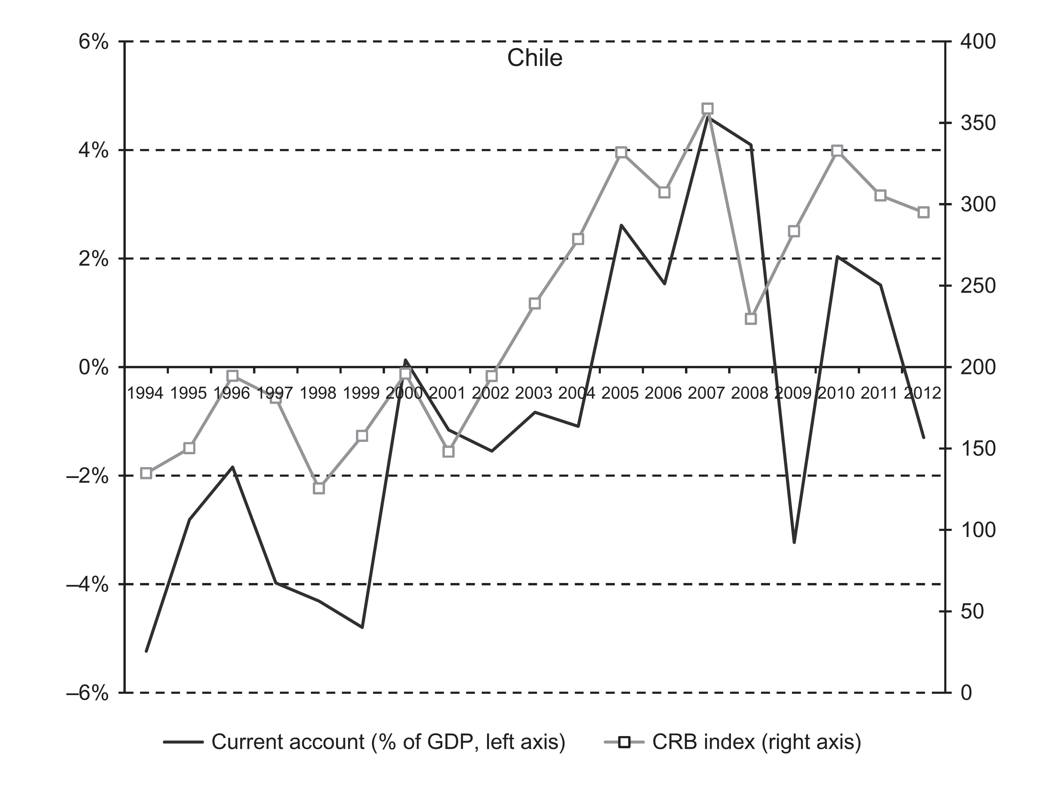
Current Account and Commodity Prices: CHile

Slide 67
Current Account and Commodity Prices: Norway

Slide 68
Current Account and Commodity Prices: Brazil

Slide 69
Oil exporting countries
The same reasoning can be used to explain the surplus in current account seen in oil exporting countries.
The price for a barrel of oil measured by the OPEC basket jumped from US$ 23.12 in 2001 to US$ 94.45 in 2008: an increase of 309%.
In this same period, the current-account balance in Saudi Arabia, the largest oil exporter in the world, went from 5.1% GDP to 23.4%.
In Iran, from 5.2% GDP in 2001 to 10.5% in 2007, and in the United Arab Emiratesfrom 2.5% GDP in 2002 to 15.3% in 2007.

Slide 70
Aging population
Countries such as Japan, Germany and Switzerland presented surpluses in current account that, at least in part, can be explained by the fact that these countries have an aging population.
Aging population => greater weight to future consumption in their utility functions (higher intertemporal discount rate $β)$ => higher savings
Aging of the population also = reduction in future active population => reduction in production = a negative income shock in the future => higher savings

Slide 71
The Voracity Effect
An increase in commodities prices has a positive effect on the current account, as previously described, as a result of the optimum decision to invest and save over time.
In practice, however, this is not always true.
Tornell and Lane (1999) show that a positive shock can actually have a negative impact on the current account of an economy with a weak legal-political institutional infrastructure and powerful organized groups.
The pressure for redistribution can be so high that, in the end, there is a higher than proportional increase in fiscal redistribution after a positive income shock.
In other words, the expenditures generated to attend the demands for redistribution are greater than the increase in income received from the increase in commodities prices, for example.

Slide 72
The Feldstein-Horioka Puzzle
We can find a large number of examples where changes in the economic scenario caused changes in the flow of foreign debt or credit that can be understood in light of the intertemporal model.
The model also delivers the strong result that the decisions to save and invest are independent.
Feldstein and Horioka (1980) tested to see if saving and investment are correlated for a group of 16 OECD countries between 1960 and 1974. They find a correlation close to 1 between savings and investment: saving and investment seem to walk hand in hand. This is the Feldstein-Horioka Puzzle.
Their interpretation: there was not sufficient capital mobility in the world.

Slide 73
Portfolio Diversification
Here is one of the explanations proposed for the puzzle, which I believe to be especially relevant today.
The intertemporal model of the current account presented here does not take into account the risks associated with investment in physical capital.
In the real world there is not only uncertainty in relation to the return on domestic investment, but also in relation to international loans.
Finance theory and popular wisdom teach us that, in a world of uncertainty, one should not put all one’s eggs in one basket.
Technically, investors should maintain a diversified portfolio.
It is based on this idea that Kraay and Ventura (2000) explain the Feldstein-Horioka Puzzle

Slide 74
Portfolio Diversification
How does optimum portfolio diversification change the predictions of the intertemporal current-account model?
Intertemporal model: a positive and temporary income shock induces greater savings, while investment remains unaltered. The result is an increase in the current-account balance.
In other words, every increase in savings is ‘saved’ in foreign assets.
In an uncertain world, the additional savings should be diversified, according to the optimum portfolio diversification.

Slide 75
Portfolio Diversification
A lender country put part of its wealth domestic and and part foreign assets: it invests a share smaller than 1 of its wealth in domestic assets.
Additional savings should follow the same pattern: a portion in domestic assets and another in foreign.
Hence, the increase in savings leads to an increase in domestic investment, with a final result of an increase in the current-account balance.

Slide 76
Portfolio Diversification
For a borrower country, the portion of wealth invested in domestic assets is greater than 1.
The country should invest a portion greater than 1 of additional savings in domestic capital.
As a result, the increase in investment is greater than the increase in savings, which causes a reduction in current account!
In sum, a temporary positive income shock leads to
an increase in current-account balance in lender countries, and
a reduction in current-account balance in borrower countries.

Slide 77
Global Current-Account Imbalances
Between 1997 and 2008: the United States, the richest country in the world, accumulated increasing current account deficits, reaching 6% of GDP in 2006.
Accompanied by a significant deterioration of public accounts, a situation known as twin deficits.
Counterpart: basically, a surplus in oil exporting countries and Asian economies, especially China.
Perplexing: according to the intertemporal current-account model, the international flow of capital should go from wealthy countries to poorer countries.

Slide 78
Global Current-Account Imbalances
The intertemporal current-account model studied in this chapter does not seem to be able to explain the global imbalances of the 2000s. Why?
The fact that the bonds are not identical between countries has been pointed out as a fundamental element in generating these imbalances.

Slide 79
Global Current-Account Imbalances
Reasons for higher foreign savings for oil exporter countries and Asian countries.
Reduce exposure to external crisis (eg. South Korea)
Increase in terms of trade (oil and commodity exporting countries)
Aging population with precarious retirement and social security systems (China)
These three reasons required secure, long-term financial products.
Emerging developing countries do not have this type of asset available.

Slide 80
Global Current-Account Imbalances
The United States, on the other hand, had a “comparative advantage” in long-term assets
Moreover, they American assets are denominated in dollars, which is the currency most used in international transactions
The American deficit in current account would have been, therefore, the counterpart to the “global savings glut”.
Hence, in order to understand these events, it is necessary to provide a model where assets are not perfect substitutes

